Slide 1
COMP2140/7240 – Web/Mobile Programming Lecture Week 10: Introduction to A3 & Getting Started
Dr Aneesha Bakharia (Senior Lecturer, EECS) Email: a.bakharia1@uq.edu.au

Slide 2
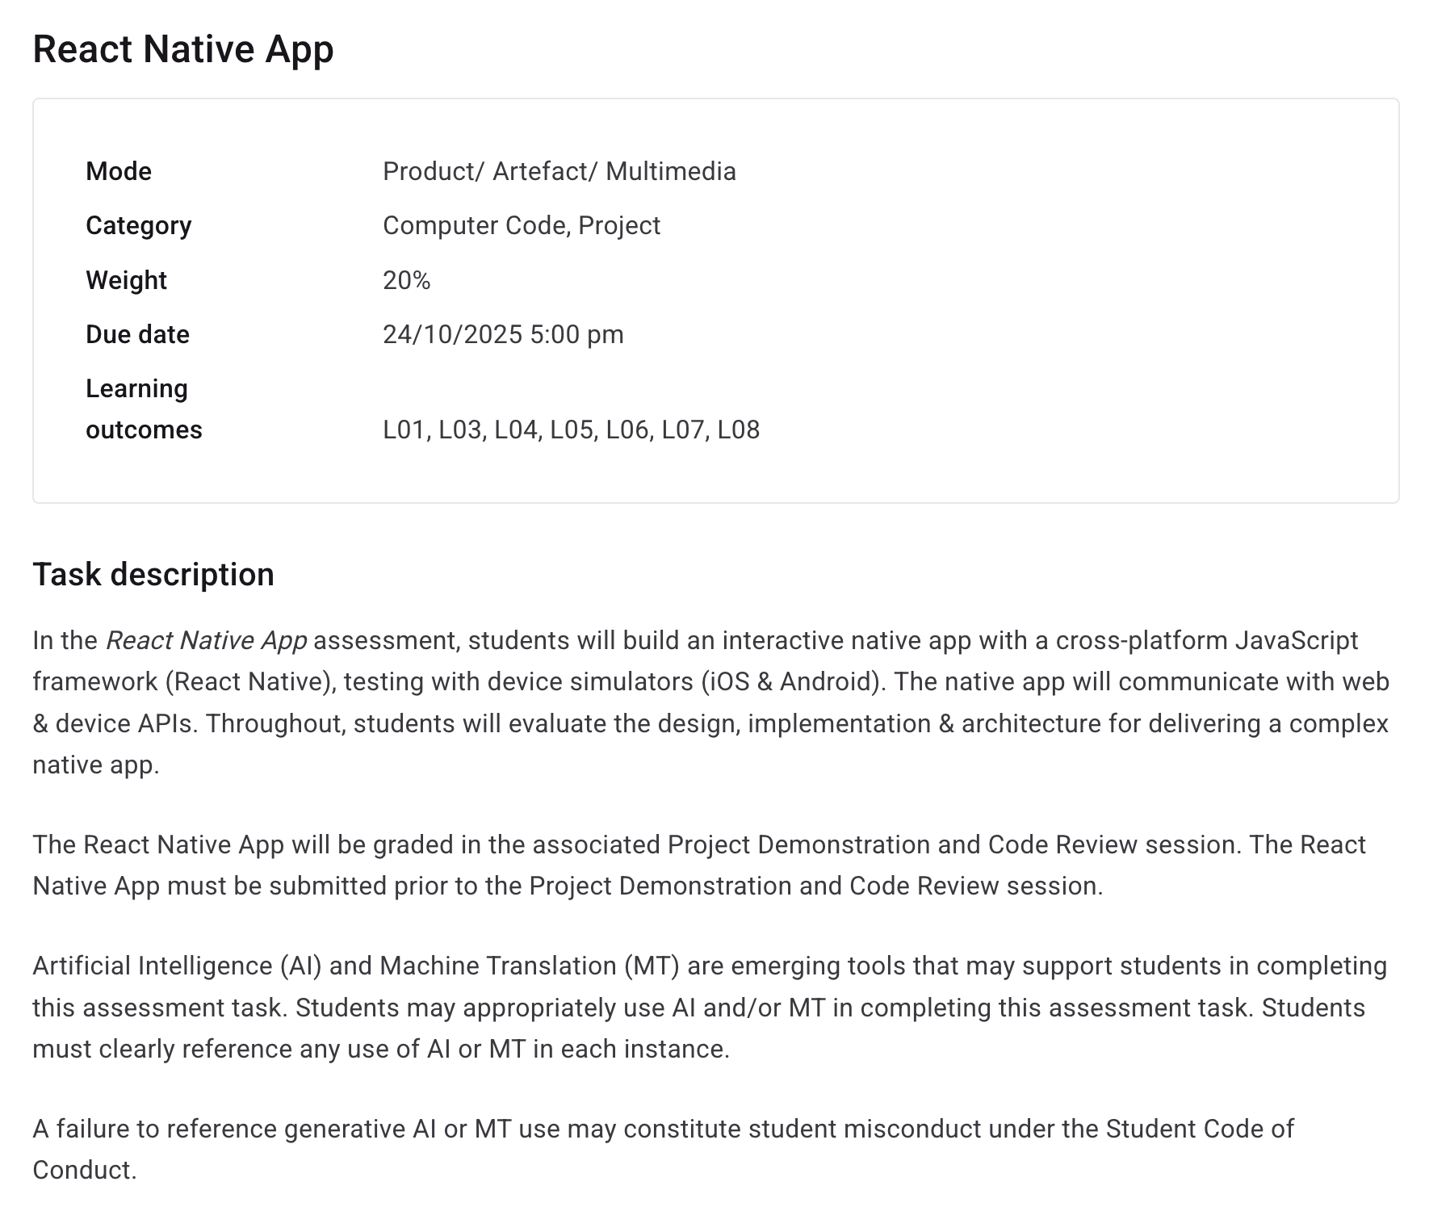
https://course-profiles.uq.edu.au/course-profiles/COMP2140-60496-7560#assessment-detail-4

Slide 3
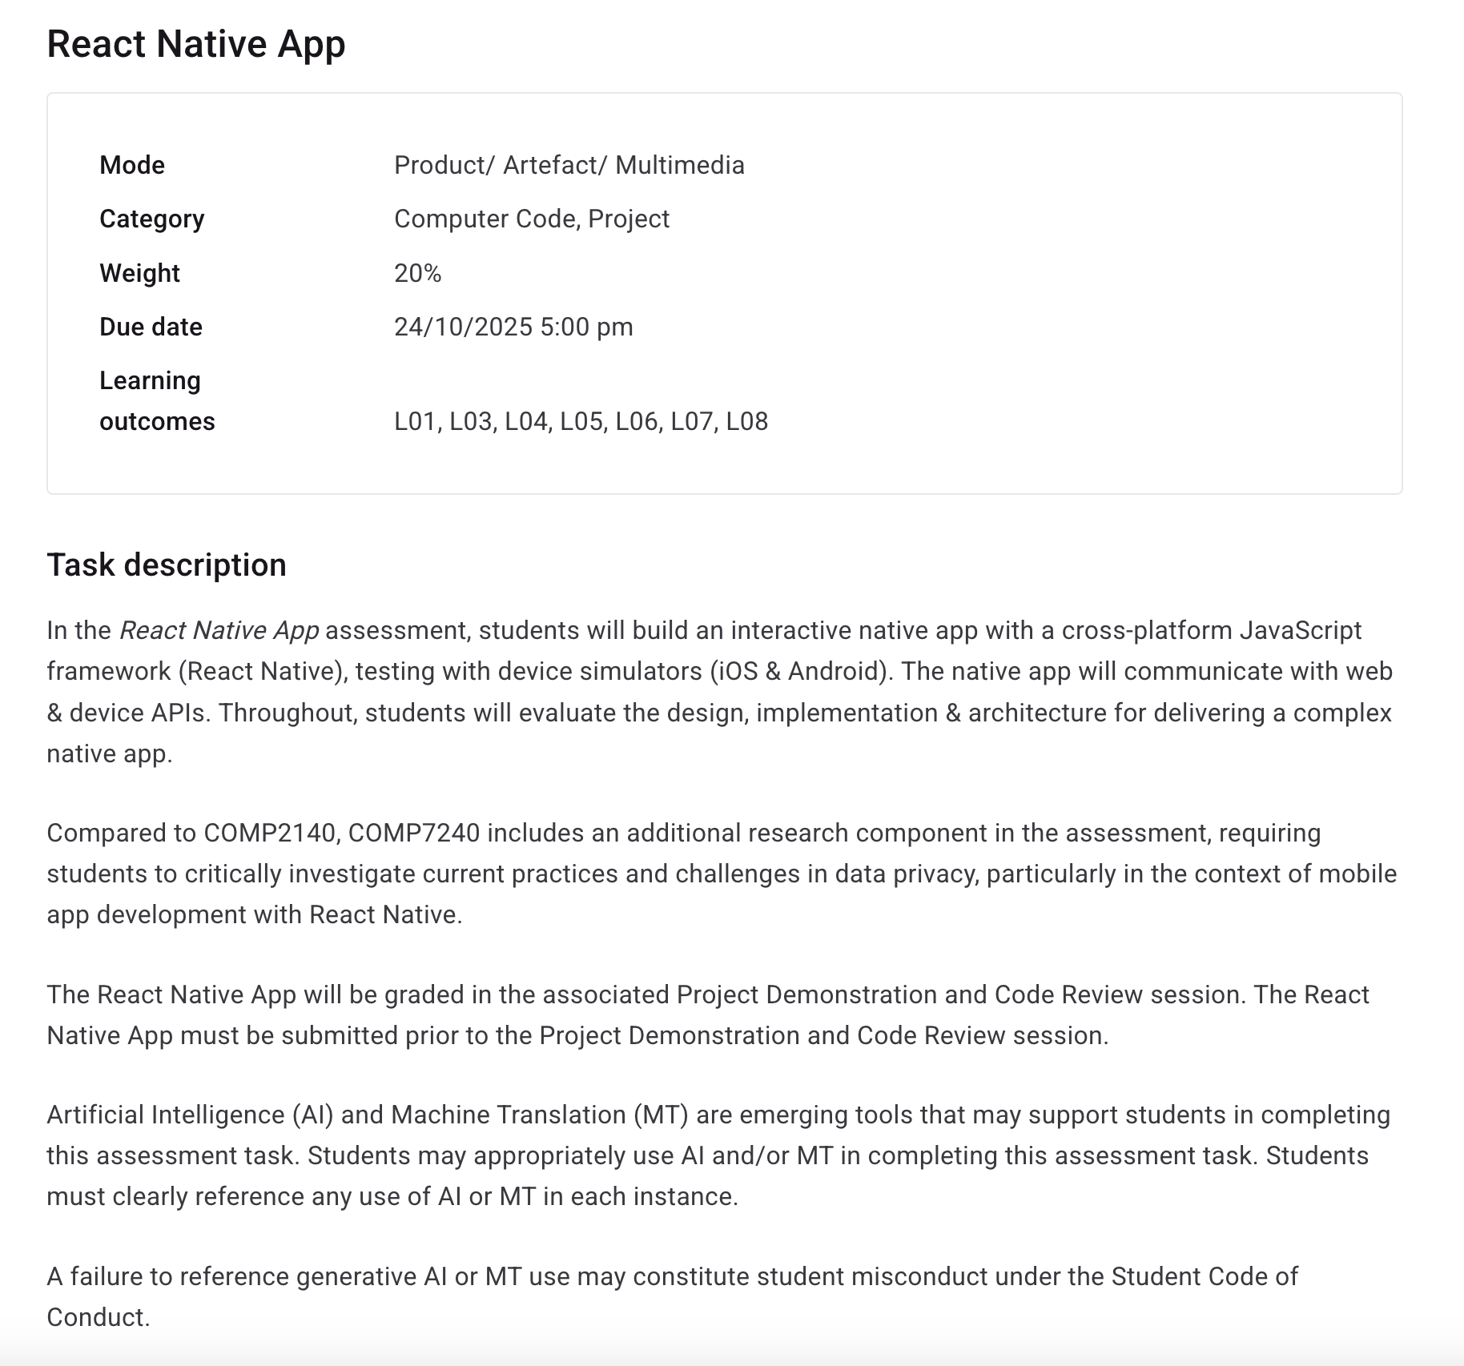
COMP7240 has a different weighting and an additional task
https://course-profiles.uq.edu.au/course-profiles/COMP7240-60085-7560#assessment-detail-4

Slide 4
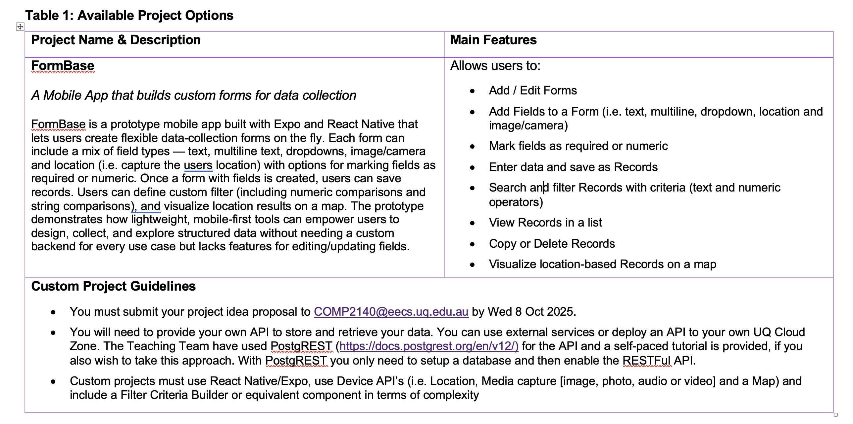
What do you need to build?
From the Brief

Slide 5
RESTFul API

Slide 6
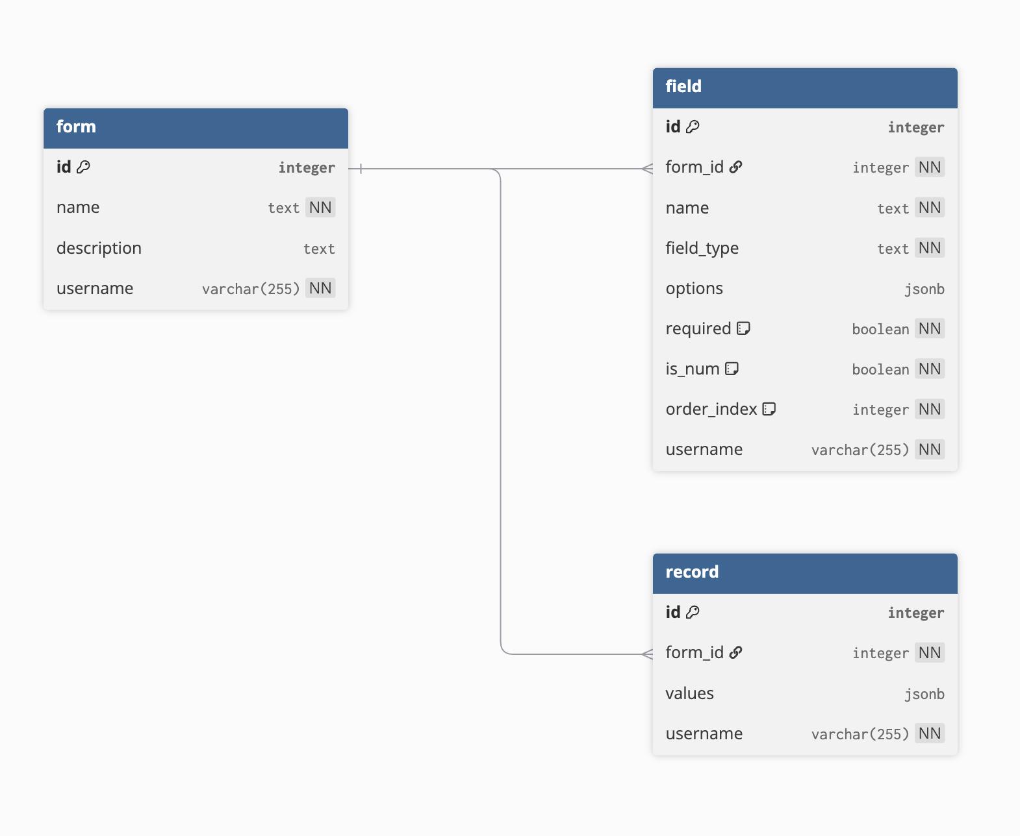
Database Schema Exposed via REST
Each field has a field_type column (e.g., text, multiline, dropdown, location, image).
This allows a single form to mix multiple kinds of inputs without schema changes.
The record.values column is JSONB, enabling storage of heterogeneous data aligned to the defined fields.
This means new field types or response formats can be added without altering table definitions.
Postgres allows for filtering on jsonb fields - so we can still build filtering into FormBase
Schema Rendered by https://dbdiagram.io/

Slide 7
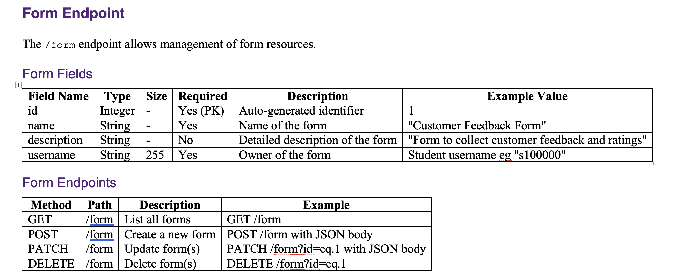
FormBase App RESTful API
https://comp2140a3.uqcloud.net/api
JWT is the same as A2
Form, Field and Record resources
Implemented using PostgREST which maps a Database to an API.
https://docs.postgrest.org/en/v12/

Slide 8
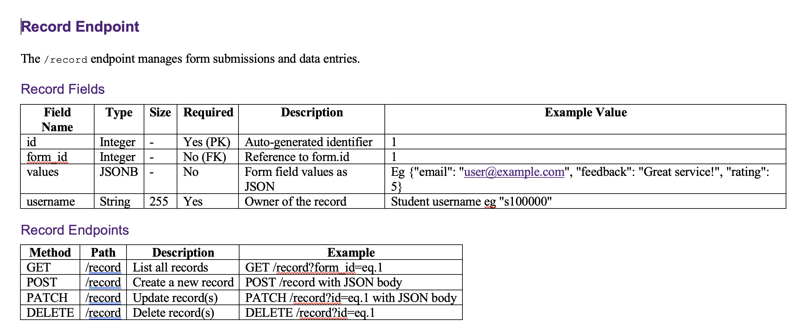
Storing Form Data - Records
https://comp2140a3.uqcloud.net/api
A jsonb field is used to store the form data Fields can be queried via the RESTFul API (which is what you’ll use in the Filter Criteria Builder)
https://docs.postgrest.org/en/v12/

Slide 9
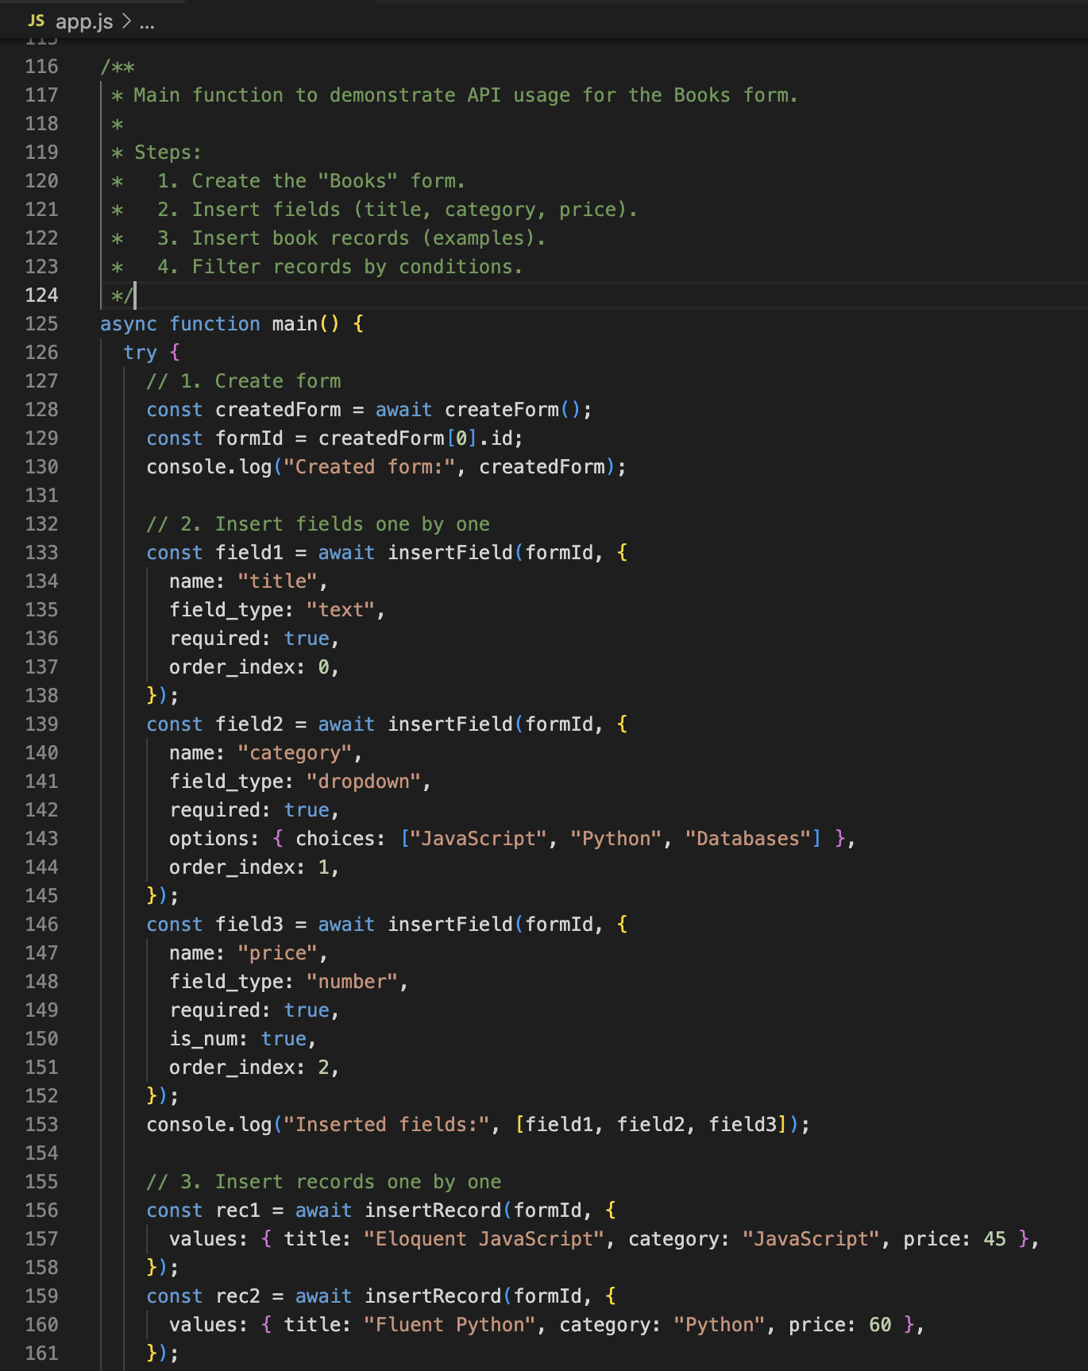
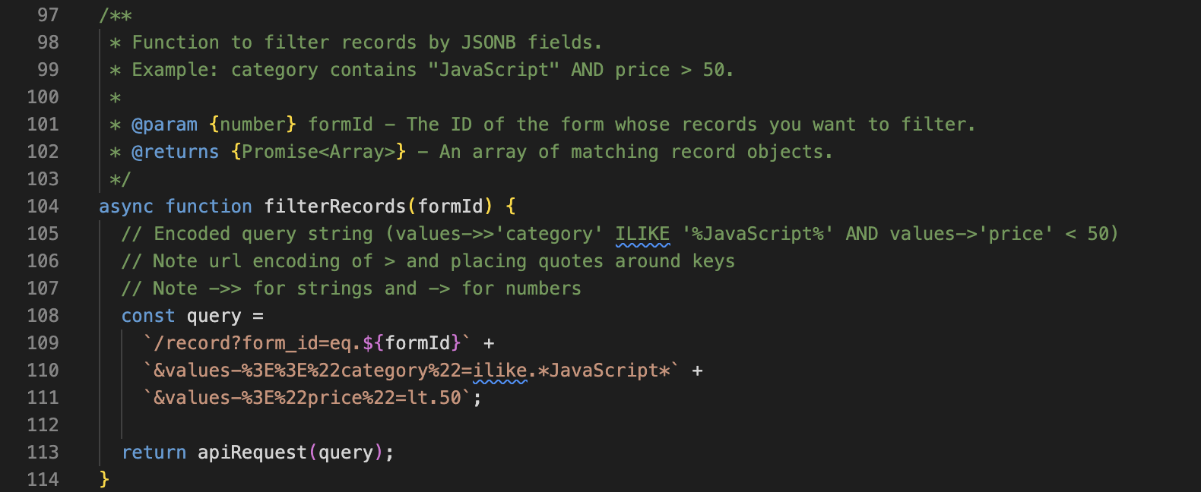
Example API Code
https://docs.postgrest.org/en/v12/references/api/tables_views.html#json-columns
formbase_sample_api_access

Slide 10
Example Screens

Slide 11
Some Guidelines to for viewing Sample Screens/Demo
They are sample screens.
You need to design your own layout and look and feel using a CSS/Component Library.
The sample screens are not designed for usability and don’t include too many user instructions. You will need to include these in your app.

Slide 12
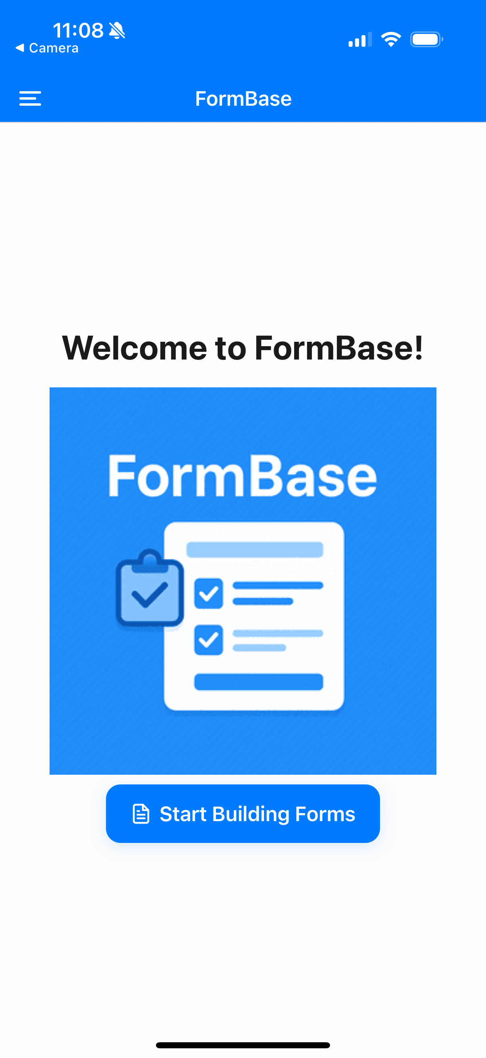
The Home/Welcome Screen

Slide 13
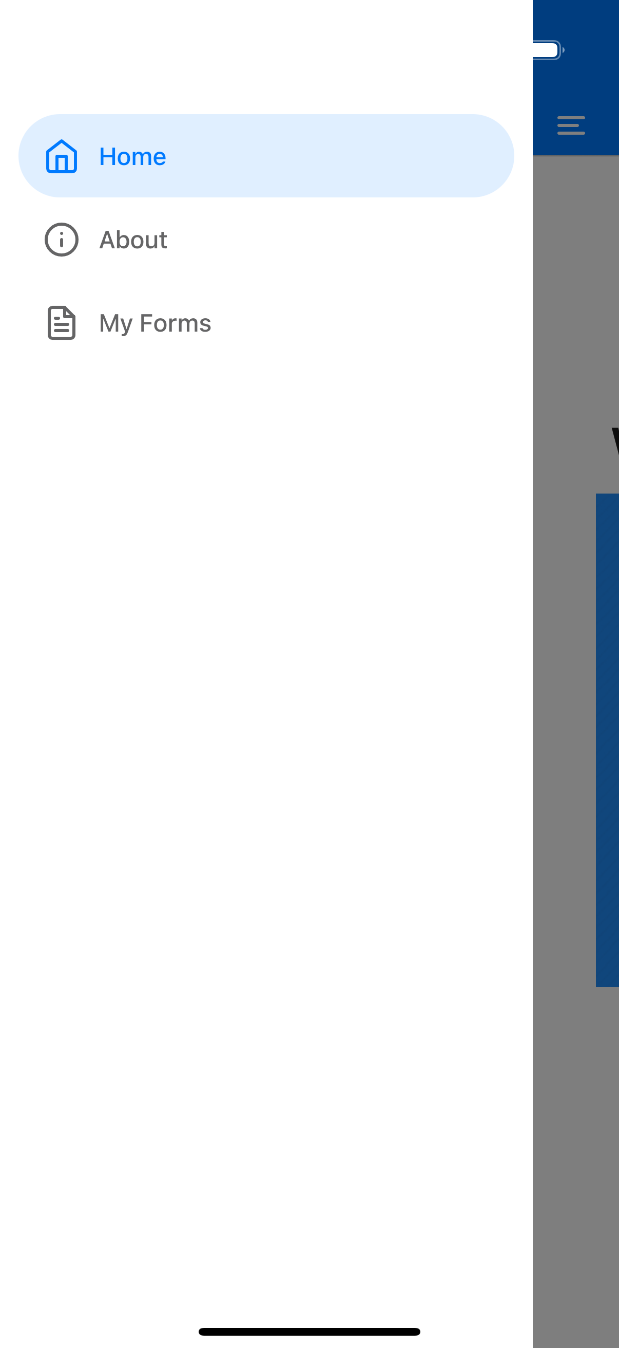
The Panel Navigation

Slide 14
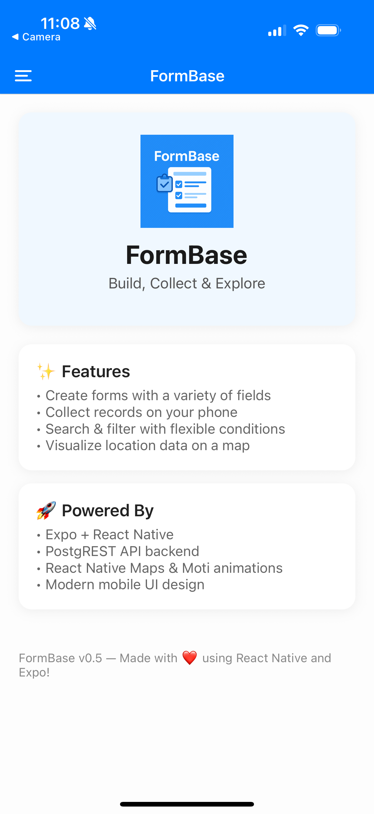
The About Screen

Slide 15
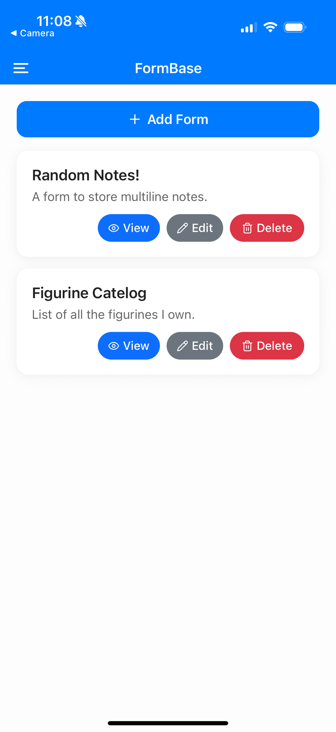
The My Forms Screen

Slide 16
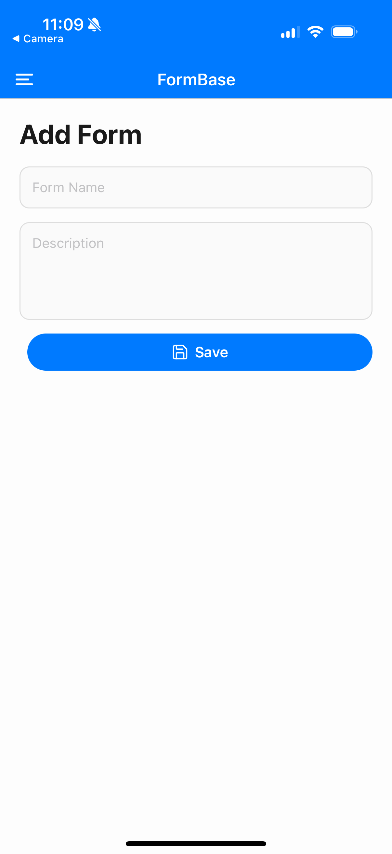
The My Forms Screen – Adding a Form

Slide 17
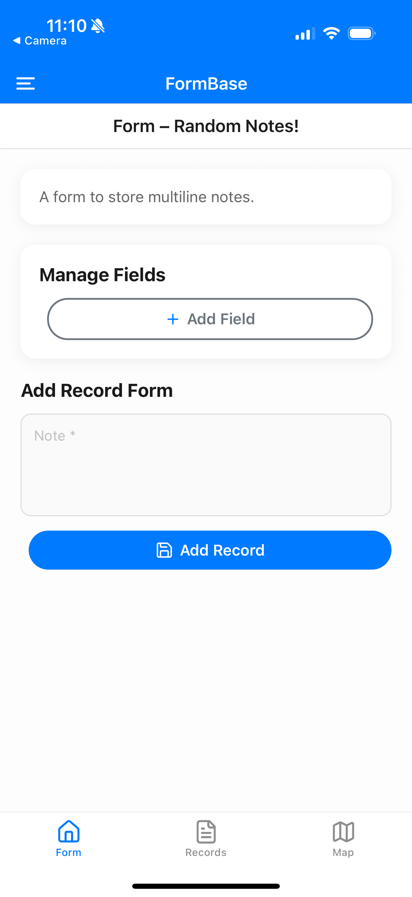
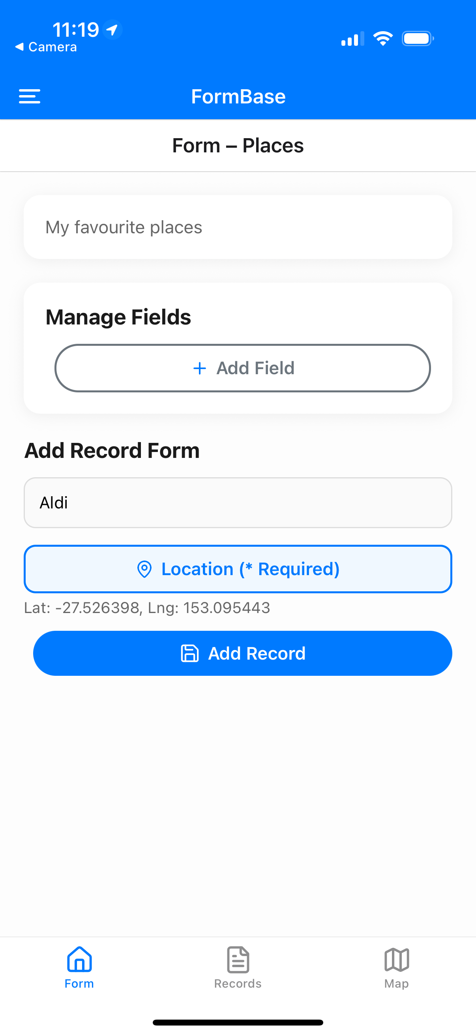
The Form Screen – Rendering a Form
Note:
No editing or deletion of form fields is required.
No re-ordering of fields is required.
You can assume the fields can’t be changed after data is entered. (This is to reduce the scope of the assessment)

Slide 18
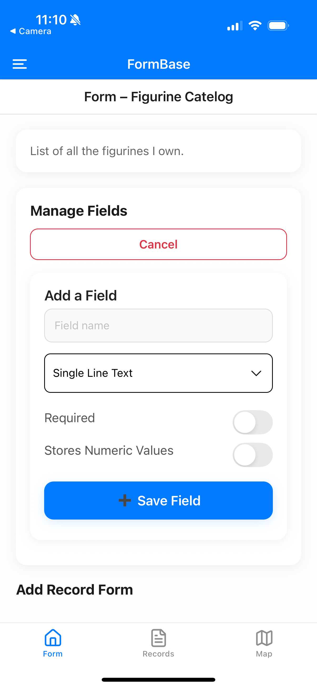
The Form Screen – Adding a Field

Slide 19
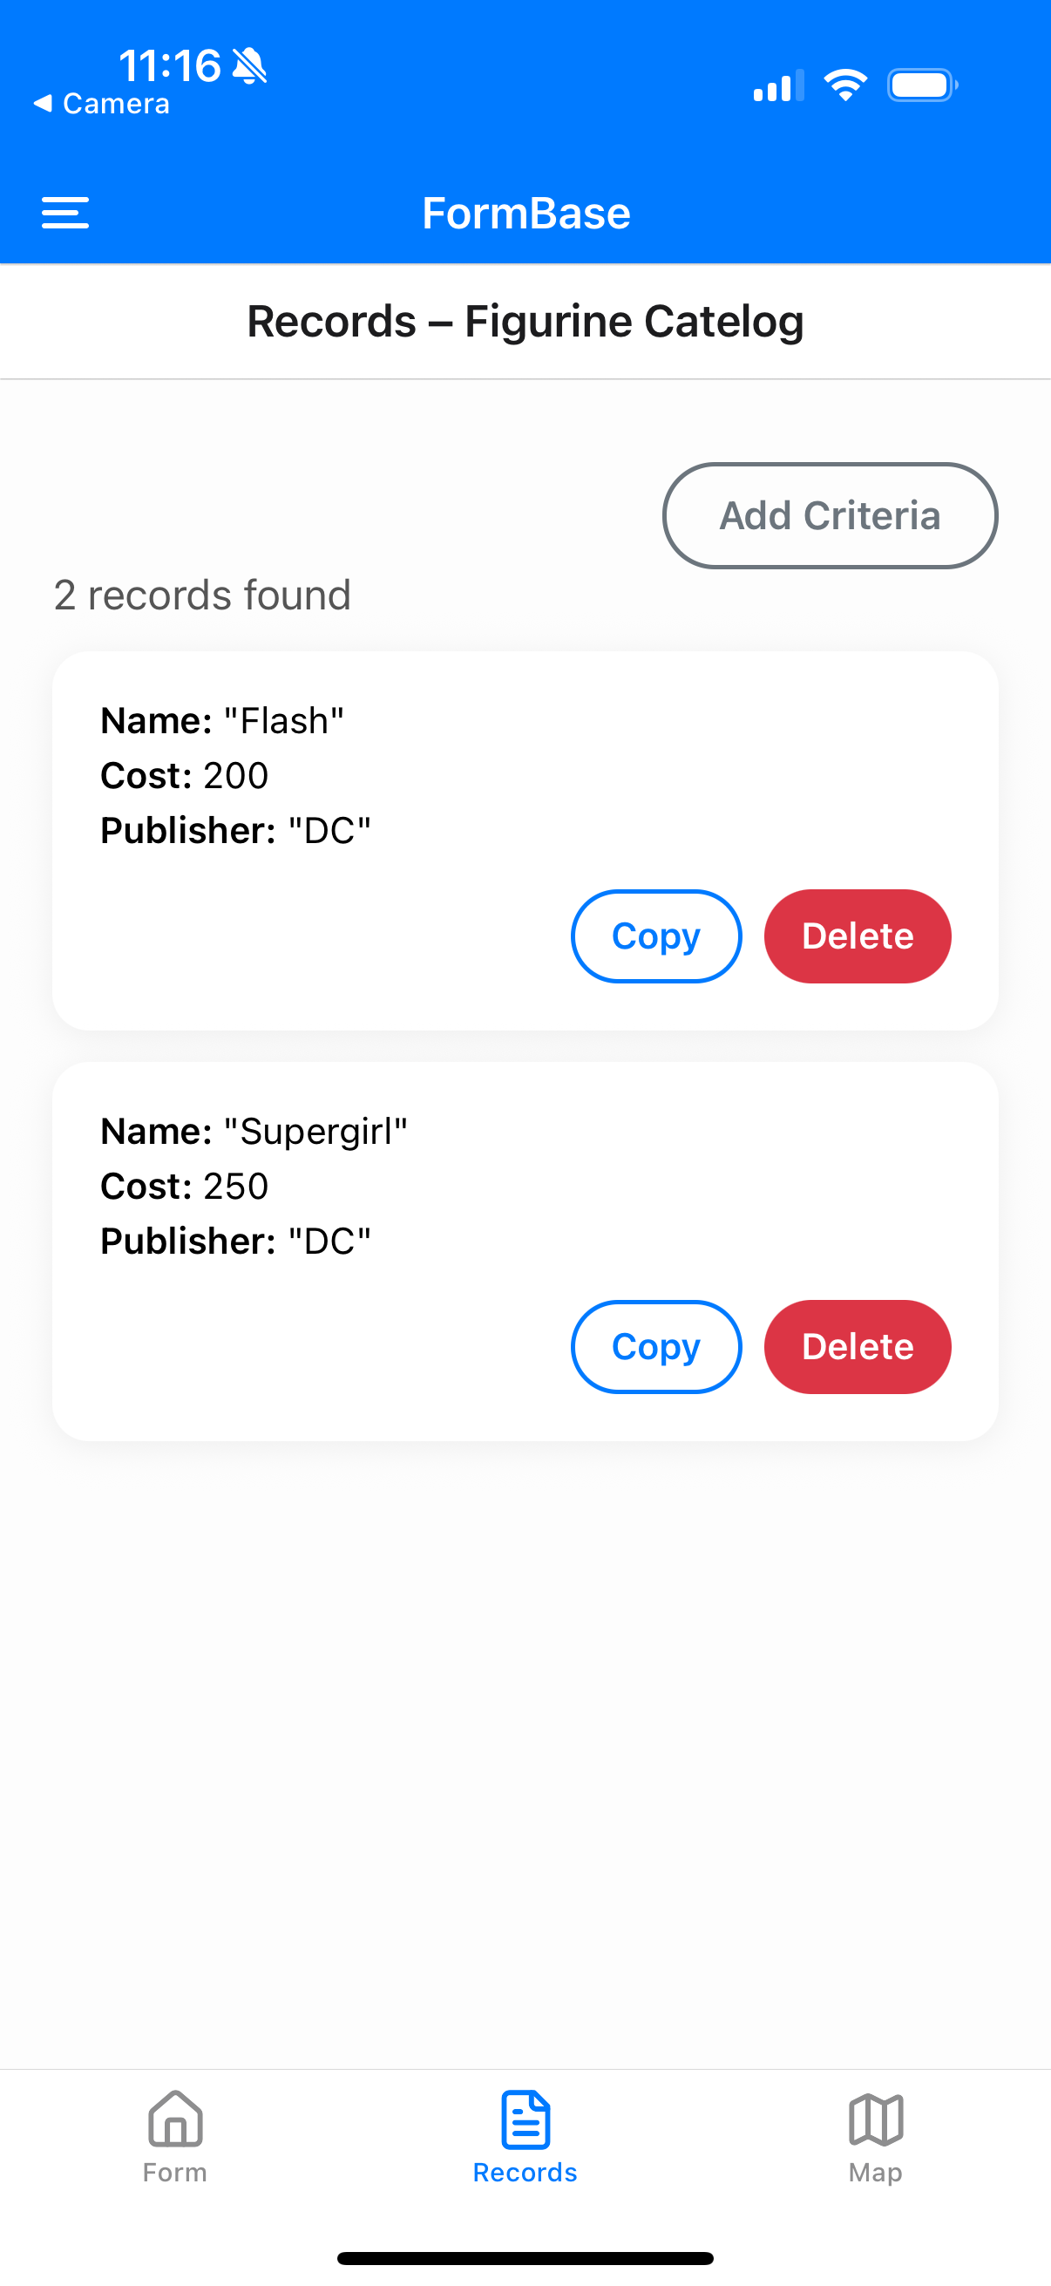
The Records Screen
Note:
No edit record is required

Slide 20
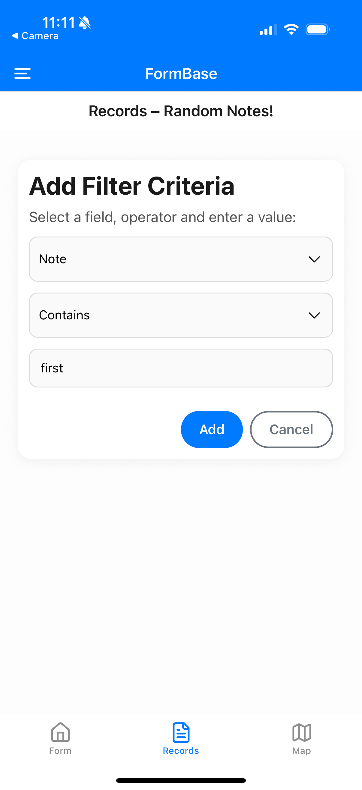
The Filter Criteria Builder

Slide 21
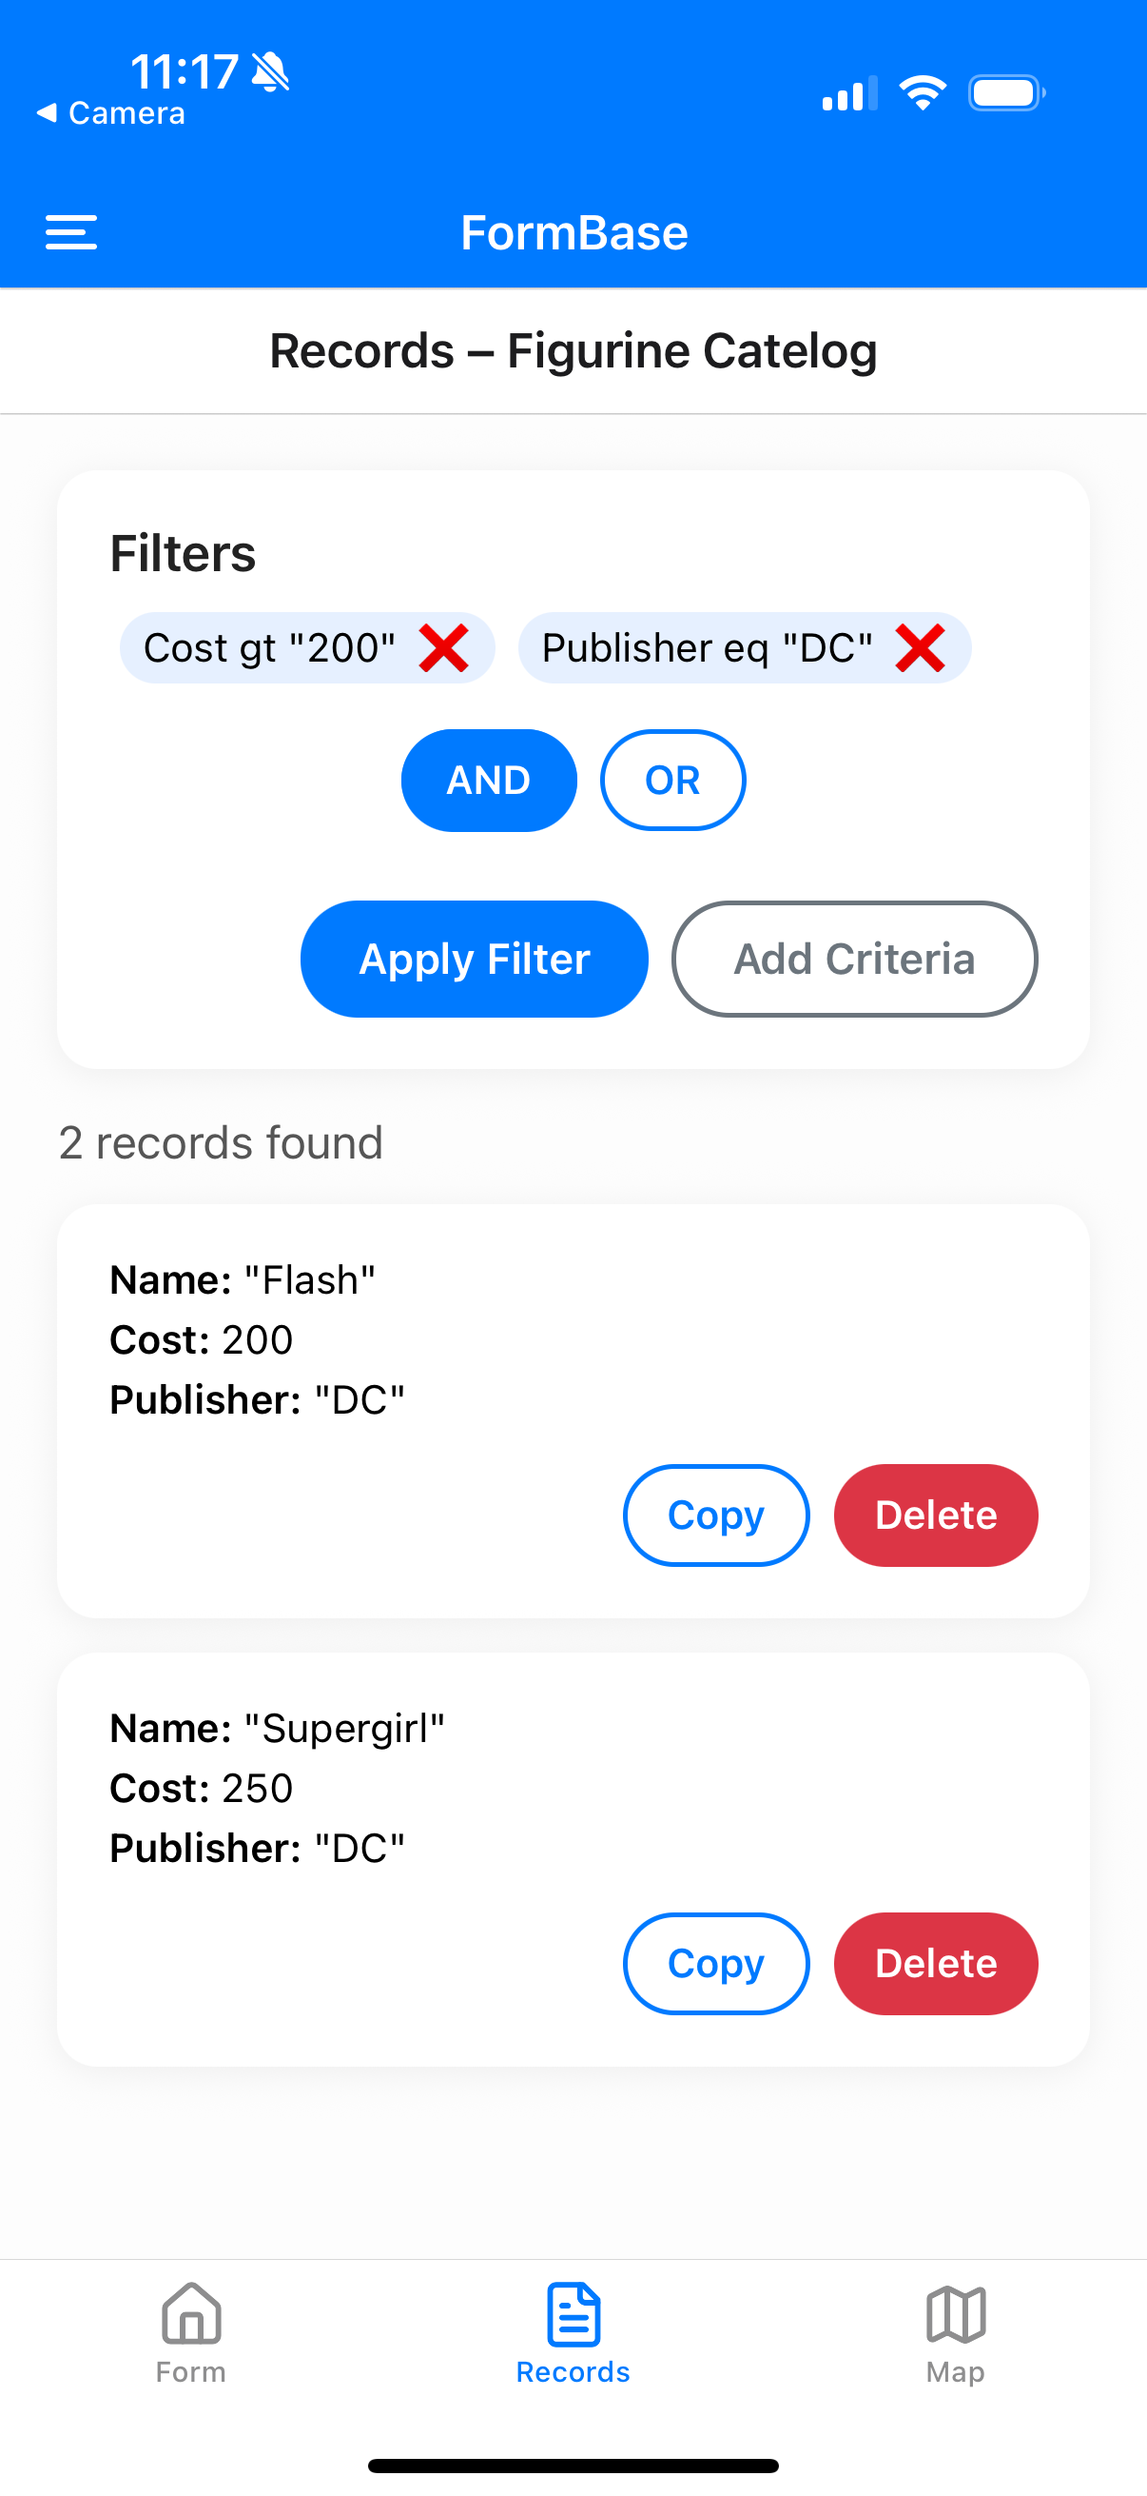
Applying a Filter and Multiple Criteria Support
Note:
Multiple criteria can be added with And/Or logic.
No complex And/Or within () are required.

Slide 22
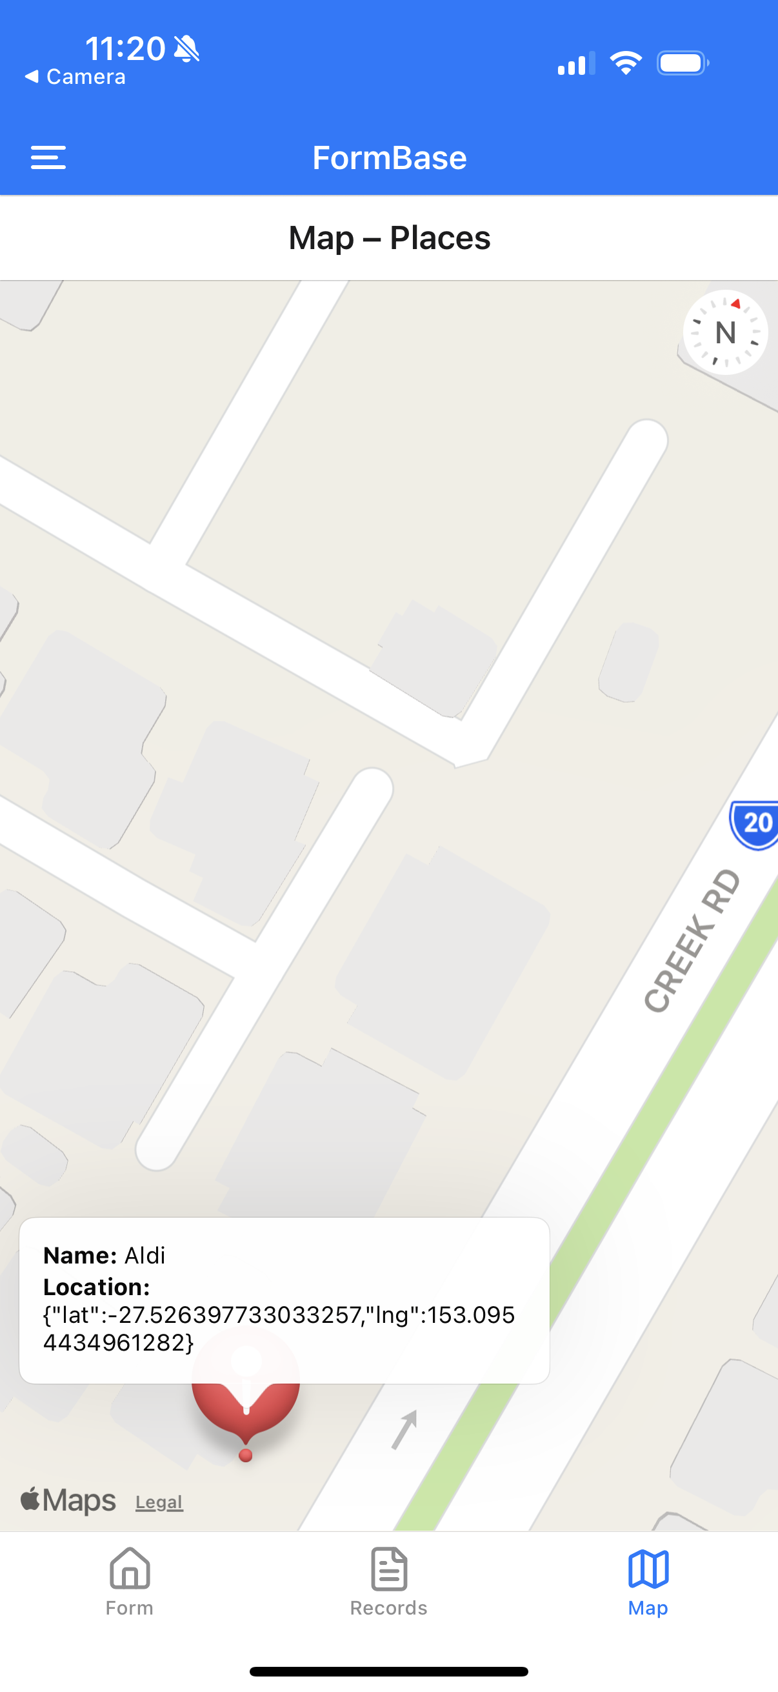
The Maps Screen
Note:
Map should only be displayed if a location fields is included on the form.

Slide 23
How do I get started?

Slide 24
How do I get started? (part 1)
Read the Assessment Brief & Rubric
Create the Expo app e.g. npx create-expo-app@latest
Setup your Expo File-based routes. The Week 9 drawer-tabs-nav example provides a good starting point. Add files for key screens.
Write your API handler for the new RESTFul API. The code will be the same as A2 but with new resources. Example API code is give with examples for filtering jsonb data.
Choose your Component/CSS Library and layout your screens
Create the Forms Screen with Add/Edit/Delete functionality
Create the Fields screen with ability to add and render fields in a form. Complete 1 field at a time so you have the overall saving and rendering working and then add support for more fields.

Slide 25
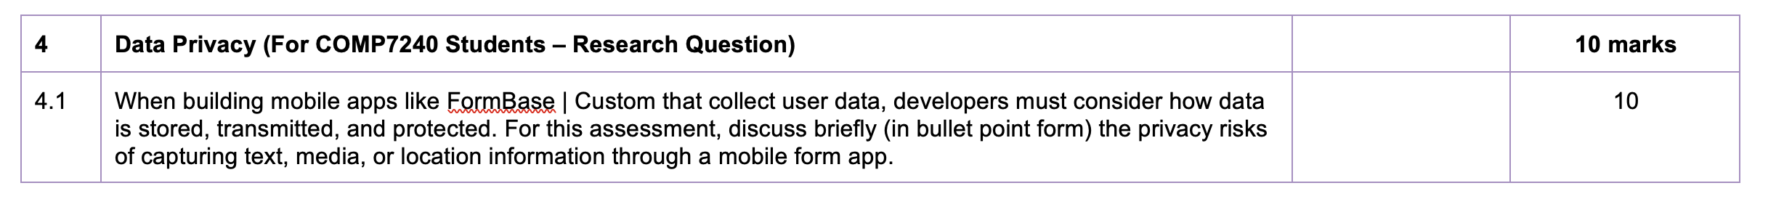
How do I get started? (part 2)
Build the Records List Screen.
Build the Map Screen (This is covered in the Applied Class)
Build the Filter Criteria Builder last This is the most complex and requires constructing of a query for PostgREST json stored data.
COMP7240 – Extra Research Task
From the Rubric

Slide 26
Tips
Start early as you’ll need a working Expo app and/or Emulator. The earlier you get this working the better. The Teaching Team is always ready to assist you.
You can re-use code from the Lectures and Applied Classes
a basic Expo file-based router navigation setup with panels and tabs (Week 9 Lecture the drawer-tabs-nav example)
Getting the users location and displaying markers on a Map (Week 10 Lecture and Self-Paced Applied Class Week 10)
Getting access to images and camera on the Mobile device (Week 11 Lecture & Applied Class Week 11)
It is easy to achieve 60 – 70% on the Assessment just by putting pieces together, but form rendering and the filter criteria builder are harder tasks to get you to a 6 or 7.

Slide 27
A3 Q&A

Slide 28
Thank you

